Slide 1
March Campus Forum
Construction and Sustainability Update
March 4, 2008

Slide 2
Topics
General Update
Construction
Heller Center , Tom Christensen
Science and Engineering, Brian Burnett
Event Center, Susan Szpyrka
Sustainability
LEED Certification, Gary Reynolds
Other efforts, Linda Kogan

Slide 3
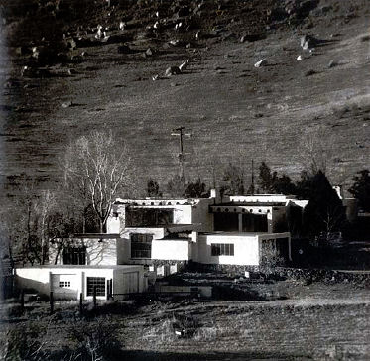
Heller Center for the Arts and Humanities
$91,000 grant from State Historical Fund of the Colorado Historical Society for development of a master plan and historic structure assessment
Gallery building stabilized - in use by classes

Slide 4
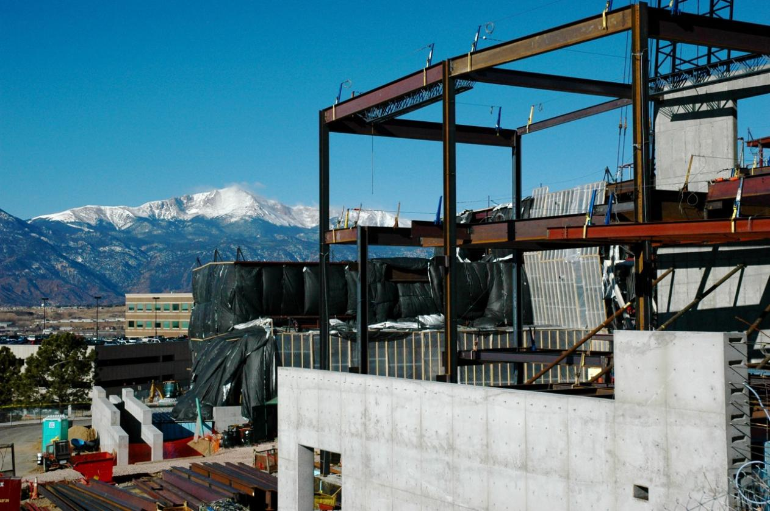
Science and Engineering

Slide 5
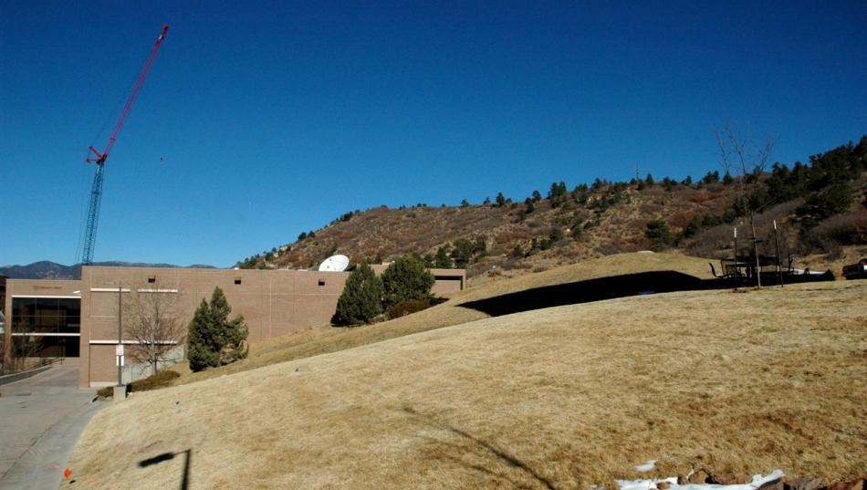
Event Center
Site: Between Dwire Hall and University Center
Budget: $7.1 million
Projected construction begin date: July 2008
Projected construction completion date: December 2009
Short term use: Multipurpose athletic and conference venue
Long term use: Upgraded conference and events center
Initial seating capacity: Approximately 1,200

Slide 6
LEED in Practice
Gary Reynolds
Facilities Services

Slide 7
LEED in Practice
Leadership in Energy and Environmental Design
Goals
To provide an objective measurement
To promote “green” building design & construction
To influence the market

Slide 8
LEED in Practice
Six Categories
Required Actions (Prerequisites)
Voluntary Actions
Points awarded for the voluntary actions

Slide 9
LEED in Practice
Six Categories
Sustainable Site (14 points)
Water Efficiency (5 points)
Energy and Atmosphere (17 points)
Materials and Resources (13 points)
Indoor Environmental Quality (15 points)
Innovation & Design Process (5 points)

Slide 10
LEED in Practice
Certified – 26 Points
Silver – 33 Points
Gold – 39 Points
Platinum – 52 Points

Slide 11
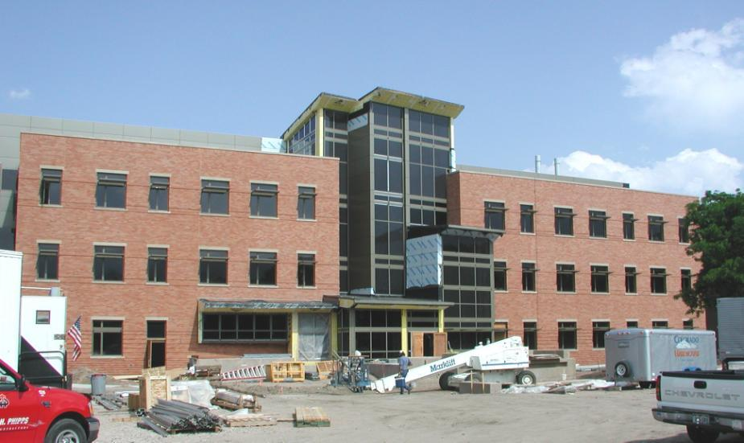
MR Credit 5.1 (1 pt.)
Local/Regional Materials 20% within 500 miles
Brick
West Elevation

Slide 12
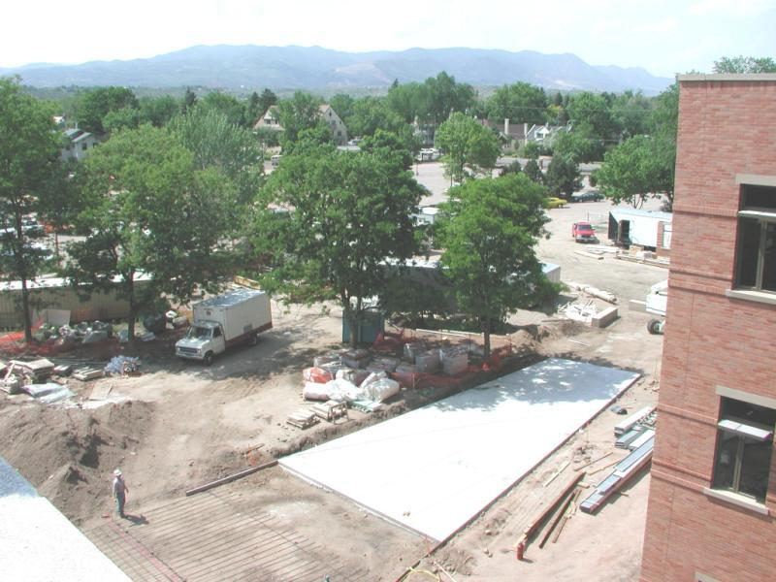
SS Credit 7.1
Low Reflectance
Exterior Materials
-gray concrete

Slide 13
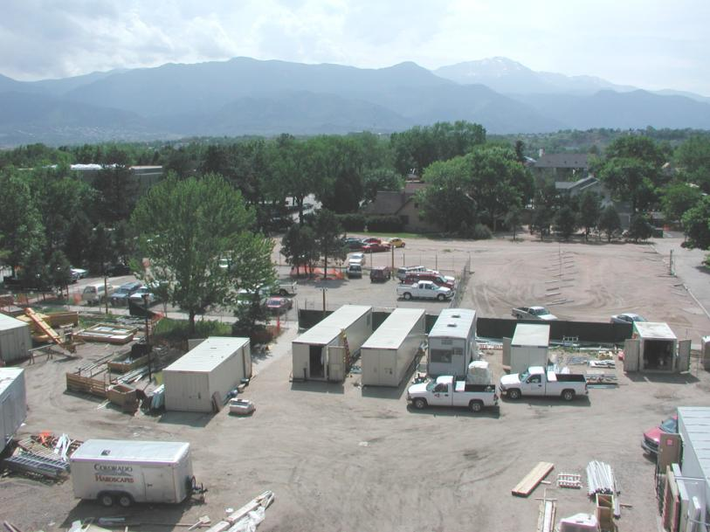
SS Credit 1
-not on farmland
-not 5’ below 100
year flood plain
-Not endangered
species
SS Credit 5.1
Reduce site
disturbance
WE Credit 1.1
High efficiency
irrigation

Slide 14
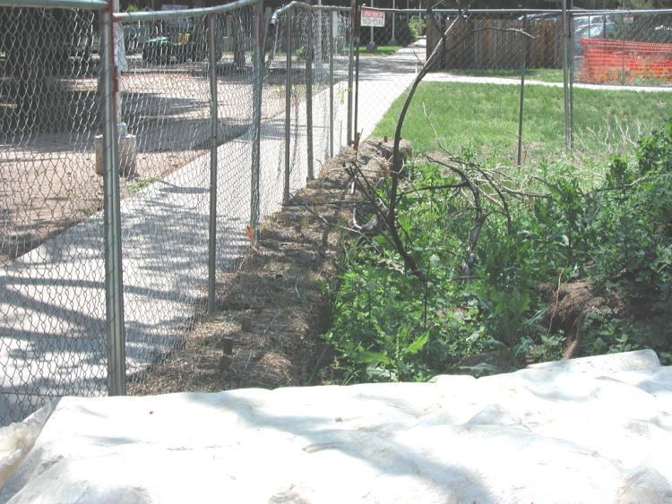
SS Prerequisite 1
Erosion Control
-Straw bales

Slide 15
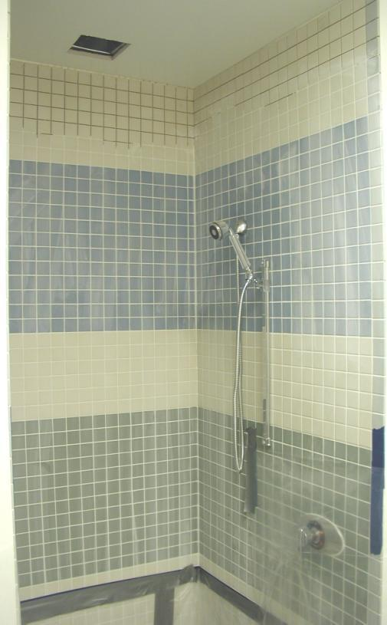
SS Credit 4.2 (1 pt.)
Changing/shower
facility for 5% of
building occupants

Slide 16
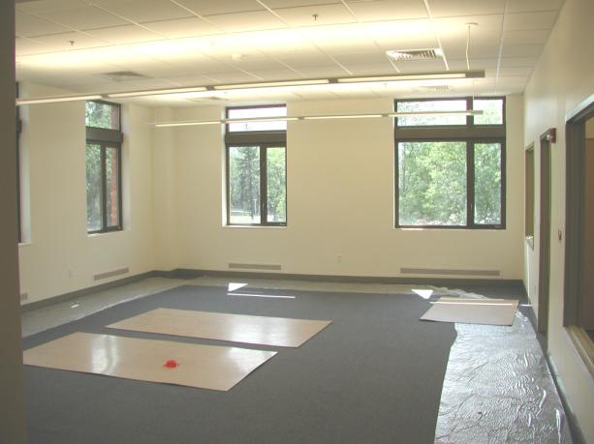
IAQ Prerequisite 1
-ASHRAE 62-99
IAQ Prerequisite 2
-no smoking
EQ 2.0 Ventilation
Effectiveness
EQ 3.1 SMACNA/protection
EQ 3.2 2 week flushing
EQ 4.1 – 4.4 No VOCs
EQ 6.2 Individual Controls
EQ 7.1 ASHRAE 55-92
EQ 7.2 Temperature &
Humidity Control

Slide 17
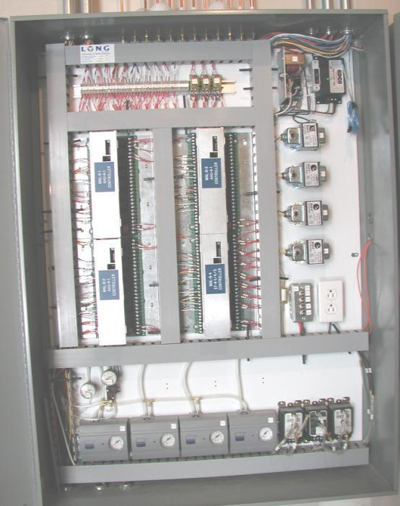
EA Credit 1.0
Many Energy Use
Reduction Strategies
Direct Digital Controls
Provides control for:
CO₂ Control
Direct O.A. Handler
ECM Strategies
Individual Room Control

Slide 18
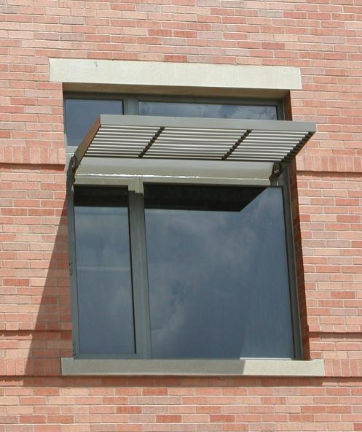
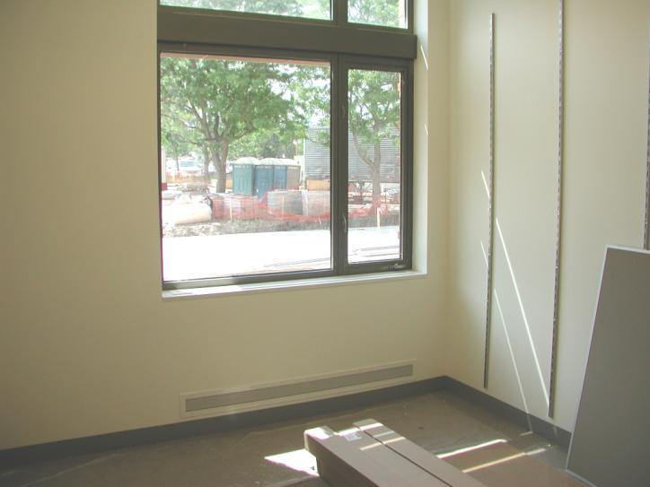
EQ Credit Daylighting
Exterior Shading
On West Window
Results of Sun Control
At 2:30 p.m. on 6/3/03

Slide 19
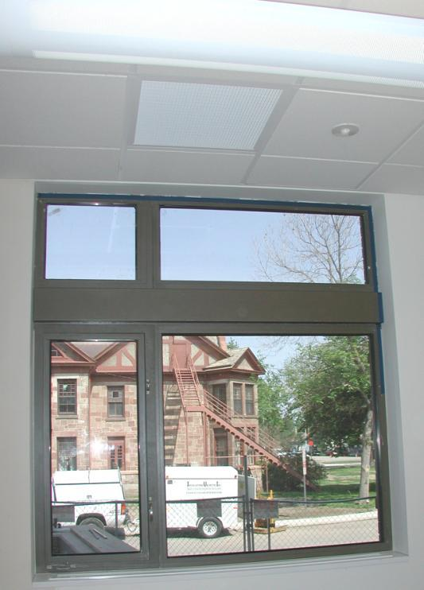
EA Credit 1.0 Reduce Energy
277 v./T8/Electronic Ballast
Lighting Control Sensor
Operable Window
EQ Credit 6.1
Daylighting
EQ 8.1 2% in 75%
EQ 8.2 Line of site

Slide 20
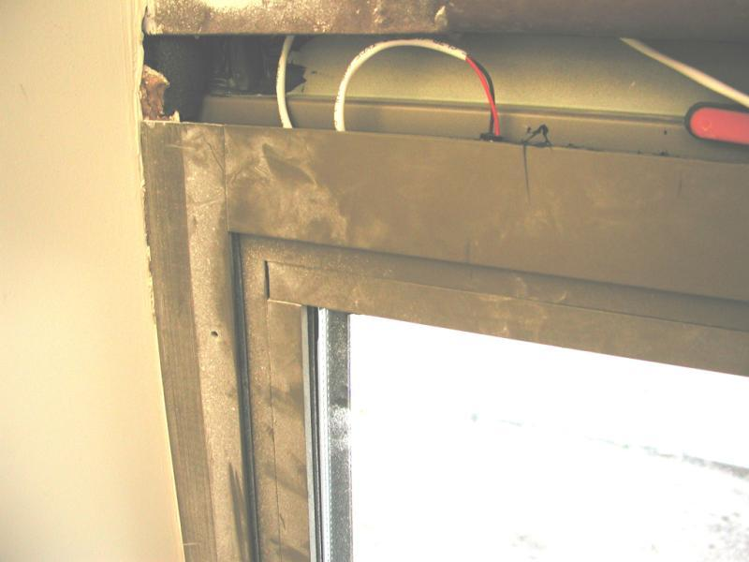
ID Credit 1
Innovative Design
Window Position
Switch

Slide 22
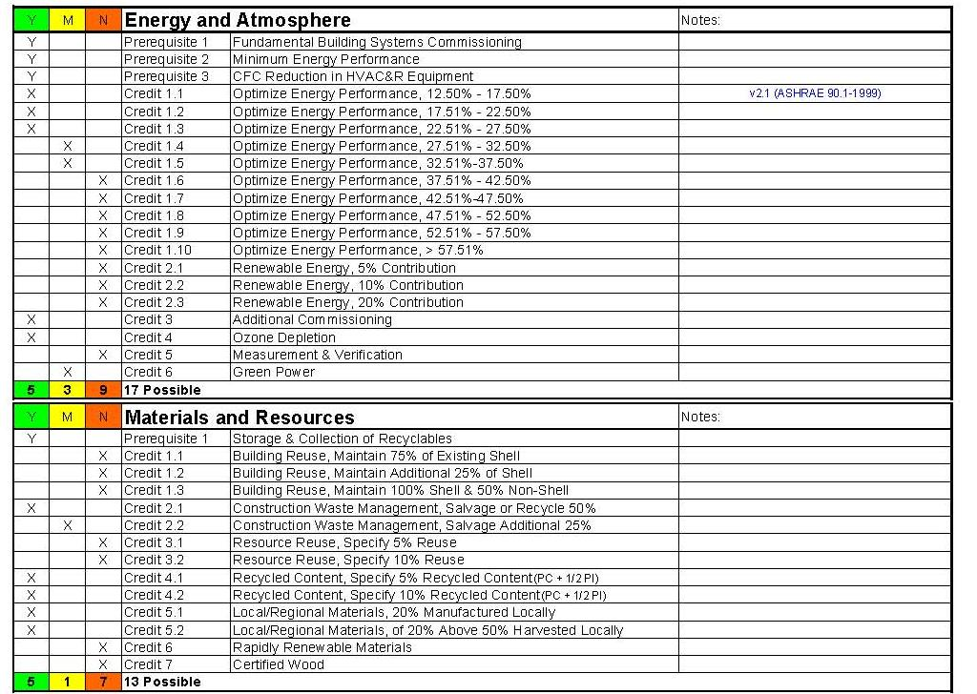

Slide 24
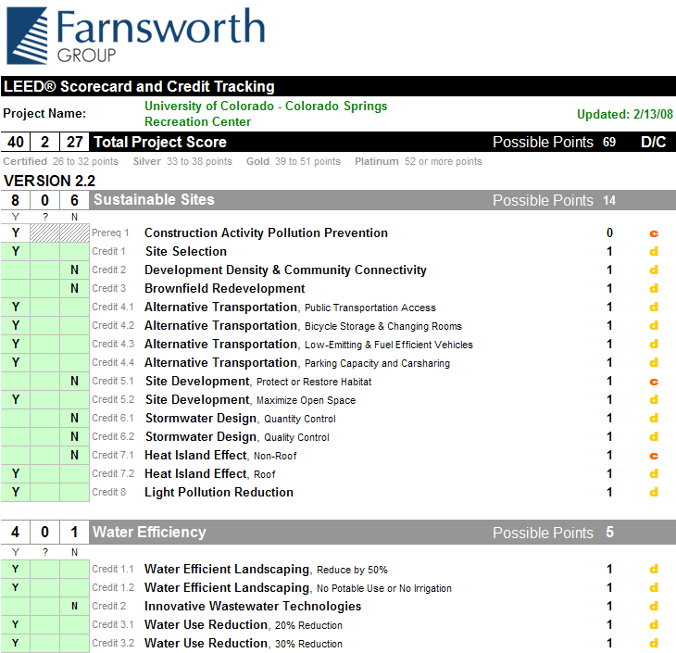

Slide 25
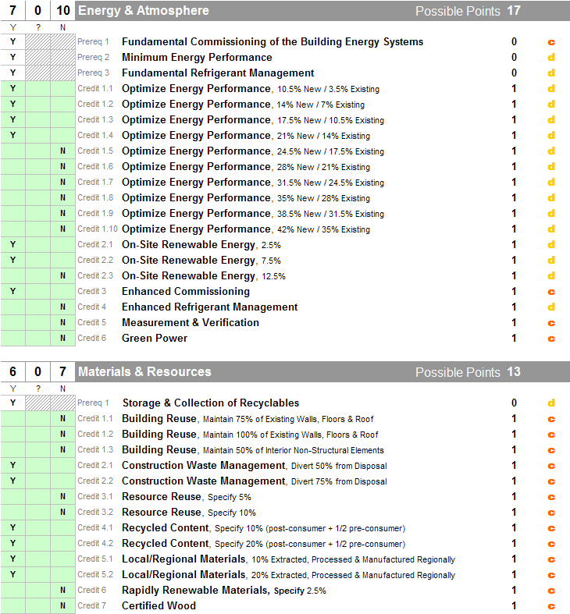

Slide 26
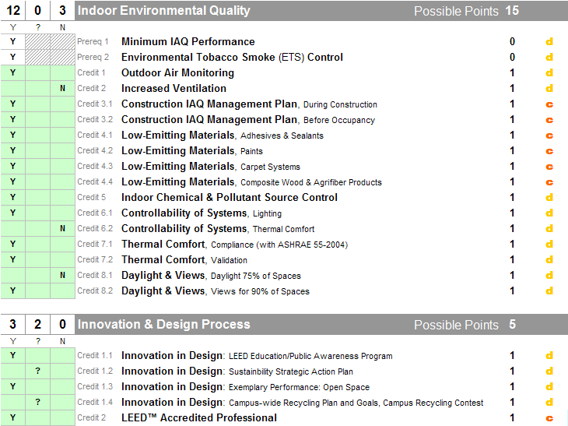
2
Yes: | Maybe:
Target Level:
40

Slide 27
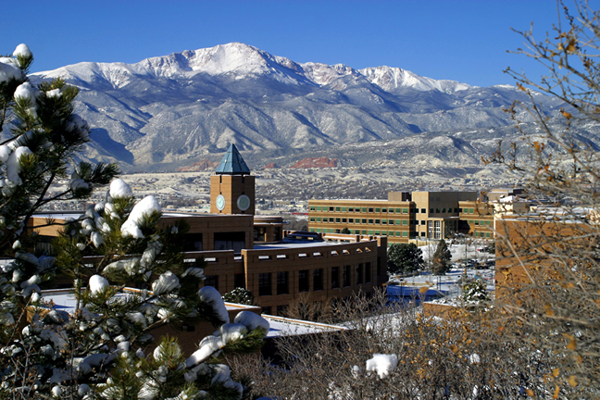
Striving toward a Sustainable Campus
www.uccs.edu/~sustain
Notes:
Thank you for having me present. There have been some exciting developments with regard to sustainability at UCCS in the last few years. We have a leadership team in place, chancellor and vice chancellors that are starting to drive our sust. Efforts. I helped to create the position of sustainability officer one year ago. My position is somewhat of a hodgepodge and includes everything related to sustainability on the campus. I have had a busy year. Highlights include review of this Facilities Strategic Plan, input into new building construction (we have 2 new buildings in construction that are going for LEED certification), I manage a $1.3 million energy performance bond to identify conservation projects, I am involved in encouraging operating and maintenance projects to reduce energy and water consumption. I am currently directing a sustainability task Force to develop sustainability goals for the campus and finally, I help to support asustainability education on campus including our new Sustainability Minor.
In other words, I am involved enough at the university to be dangerous.
What I want to focus on in this presentation is a snapshot of our recent Facilities Strategic Plan (traditionally known as a Master Plan) and to highlight how sustainability concepts has driven this process. I am not a traffic engineer or a city planner, so I will focus on our process and the final product of our architects.

Slide 28
UCCS Sustainability Update
UCCS 2007 Sustainability Strategic Plan
American College and University Presidents Climate Commitment
Colorado Greening of State Government Executive Orders
Energy and water projects
Sustainability Tracking and Rating System
Recycling

Slide 29
UCCS 2007 Sustainability Strategic Plan
40+ faculty staff and students
5-year targets and action plans in 3 key areas
Leadership, Education, Operations
First time incorporation into UCCS Strategic Plan
Development of formal sustainability council – Sustainability Plan Oversight Committee – to pursue and report on progress and serve as an advisory group to UCCS on all sustainability and sustainable development issues
www.uccs.edu/~sustain

Slide 30
American College and University Presidents Climate Commitment
Global climate destabilization and our mitigation efforts will shape the 21st century. Colleges and universities must exercise leadership in their communities and throughout society by modeling ways to eliminate global warming emissions, and by providing the knowledge and the educated graduates to achieve climate neutrality.
UCCS one of the charter members to sign commitment
498 chancellors and presidents have signed the commitment
All of the CU system has signed
www.presidentsclimatecommitment.org

Slide 31
ACUPCC Commitment
Presidents signing the Commitment are pledging to eliminate their campuses’ greenhouse gas emissions over time. This involves:
Completing an emissions inventory
Within two years, setting a target date and interim milestones for becoming climate neutral
Taking immediate steps to reduce greenhouse gas emissions by choosing from a list of short-term actions
Integrating sustainability into the curriculum and making it part of the educational experience
Making the action plan, inventory and progress reports publicly available

Slide 32
ACUPCC Commitment – UCCS Progress
Climate Action Committee formed
3 short-term actions:
Energy Star Policy for purchasing appliances
Green building – commitment to achieving the highest level of LEED certification (within 5% of the budget) for buildings that receive over 25% state funding. For others, UCCS will implement an internal audit system to pursue a LEED silver equivalent.
Waste minimization – UCCS is participating in the waste minimization portion of RecycleMania - Using less products created from virgin materials reduces greenhouse gas emissions

Slide 33
ACUPCC Commitment – UCCS Progress
Longer term actions
Developing greenhouse gas inventory
Developing strategies to increase energy efficiency and reduce energy use
Exploring renewable energy opportunities for the campus
Curriculum working group currently identifying potential strategies to ensure that all graduates are knowledgeable about sustainability and climate change

Slide 34
Colorado Greening of State Government Executive Orders
Goals for state agencies by June 30, 2012:
20% reduction in energy use
20% reduction in paper use
10 % reduction in water consumption
25% volumetric reduction in state vehicle petroleum consumption
Each state department and campus will create a sustainability management system to track and report its greening government performance.

Slide 35
Energy and Water projects
2005 Energy Performance Bond - $1.3 to pursue
energy and water saving project identified in audit
Lighting retrofit (T-12 to T-8’s, Exit signs, occupancy sensors, etc.)
Digital Direct Control system installation
Evaporative pre-cooling and new chiller for Dwire Hall
Building envelope upgrades for Dwire Hall
Toilet retrofit Columbine, Campus Services, U Hall
We are in the process of developing the next phase of energy and water projects to reach state and climate commitment goals.

Slide 36
AASHE – STARS Sustainability Tracking and Rating System
UCCS is participating as a pilot institution in the STARS program. February - December 2008
A voluntary, self-reporting framework for gauging sustainability progress to:
Provide guide to advance sustainability in all sectors of higher education, from education and research, to operations and administration
Enable meaningful comparisons over time and across institutions by establishing a common standard of measurement for sustainability in higher education
UCCS is a member of AASHE www.aashe.org

Slide 37
UCCS Recycling Program
UCCS Sustainability Strategic goal:
UCCS will achieve a 26% recycling rate.
Comprehensive recycling program started August 2007
Collect all mixed paper and mixed containers including glass, aluminum, tin, steel, plastics #1-7** and cardboard
Semester 1 –Infrastructure – mixed paper bins in office, mixed container bins in classrooms, signage
Semester 2- RecycleMania – national friendly competition to see which school can recycle the most
Semester 3 – Increase education – especially to incoming freshmen. Expand recycling efforts to cartridges, electronics

Slide 38
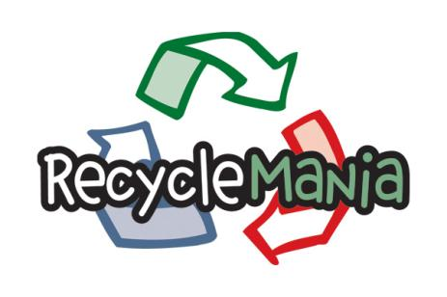
RecycleMania
4 week progress report
Waste 118,596 lb.
Recycling 40,467 lbs.
Recycling rate 25.44%
39th in competition – 400 schools

Slide 39
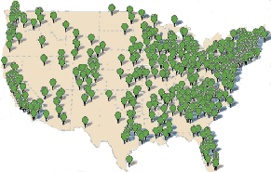
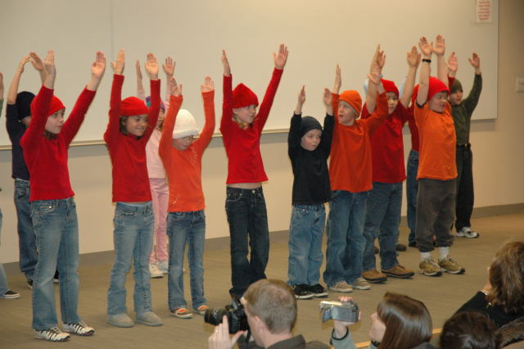
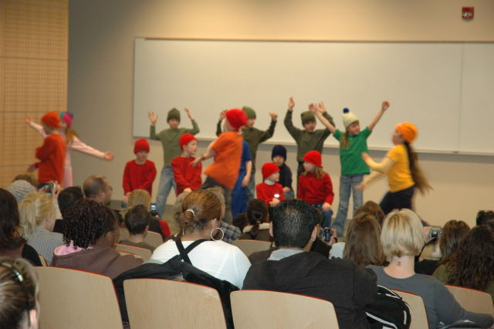
January 31, 2008
“We owe our young people at least a day of focused discussion about global warming solutions for America.”
Notes:
Focus the Nation - Focus the Nation is organizing a national teach-in on global warming solutions for America—creating a dialogue at over a thousand colleges, universities, high schools, middle schools, places of worship, civic organizations and businesses, and directly engaging millions of students and citizens with the nation’s decision-makers. Focus the Nation will culminate January 31st, 2008 in simultaneous educational symposia held across the country. Our intent is to move America beyond fatalism to a determination to face up to this civilizational challenge, the challenge of our generation.
Involved the community in our sustainability efforts
Interfaith panel discussion
Presentation by 2nd graders from the Da Vinci Academy on Dr. Seuss’s Lorax – a timely tale even though it was written 37 years ago

